Slide 1





TWO INITIATIVES ON AUTONOMOUS VEHICLES AT MIRAMON TECHNOLOGY PARK (Citymobil2 & PRT MIRAMÓN)
Jesus Murgoitio¹
Maria Izaguirre²
(1) Tecnalia Research & Innovation
(2) Novadays
1st MOVESMART Workshop
Renewable Mobility Services in Smart Cities:
Challenges, Approaches and Social Aspects
15th October 2015

Slide 2
Index
MIRAMÓN: “Test Site”
PRT MIRAMÓN:
Project summary
Objectives
Demo & Vehicle (Video)
CityMobil2:
Project summary
Objectives
Demo & Vehicle
Next actions
Conclusions
2

Slide 3
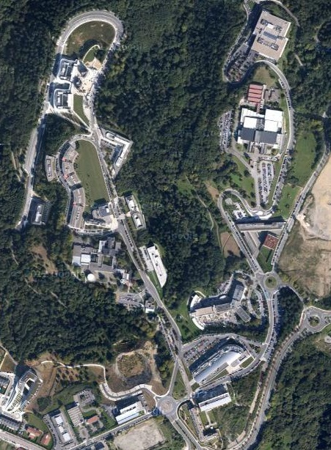

Miramón: “Test Site”
82 companies & research centers
3.633 employers (R+D+i = 41%)
581.509 m2
36 tracks & 29 buildings
Usual drivers: 67%
Occupants per vehicle: 1,2
Mobility due to job, health, studies and leisure
3

Slide 4
Miramón: “Test Site”
Adaptations for the current infrastructures:
New traffic signals (speed limit = 30 Km/h, No parking, etc…)
Painting of the road, red lines for pedestrian crossings.
Separate road lanes & Traffic control.
Ticketing integration between ARTS and public transport in San Sebastian.
Installation of the static information about ARTS: maps and information about bus stops.
Awareness campaign about advantages and disadvantages of ARTS.
4

Slide 5
Miramón: “Test Site”
Support received from many relevant institutions:
Miramón Technology park.
Regional government.
Municipality of San Sebastian.
DBUS: Urban transport system.
MLC: Cluster for Mobility and Logistic.
Legacy: Authorities like DGT for plates, etc….
5

Slide 6
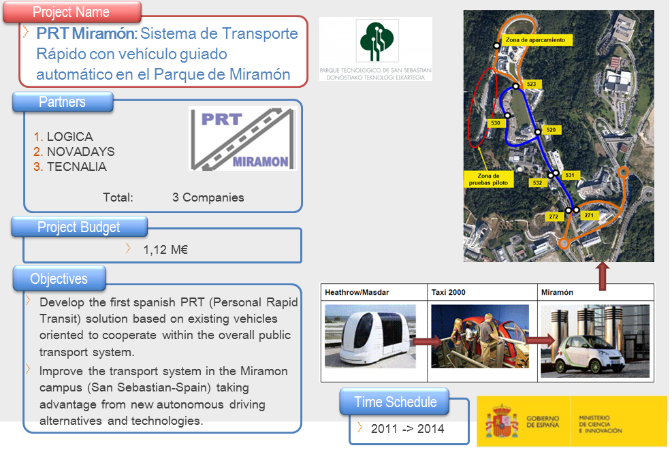

PRT MIRAMON: Project summary
6

Slide 7
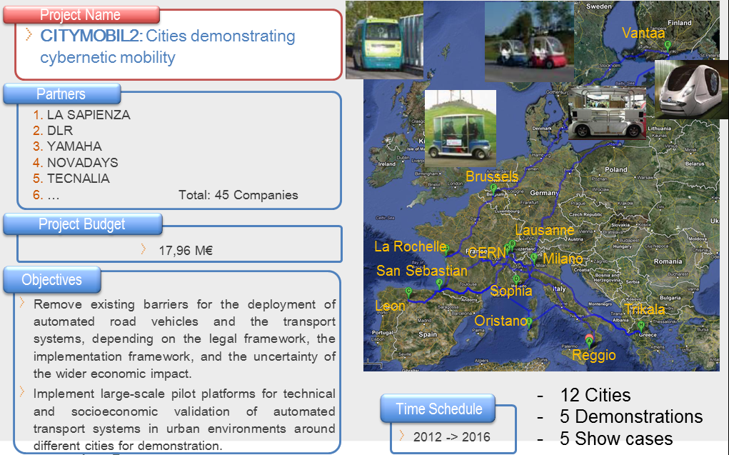
CityMobil2: Project summary
7

Slide 8
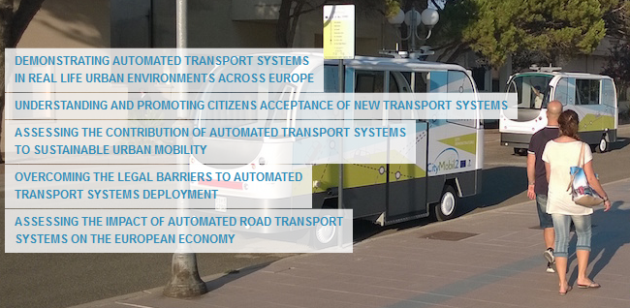
CityMobil2: Objectives
8

Slide 9
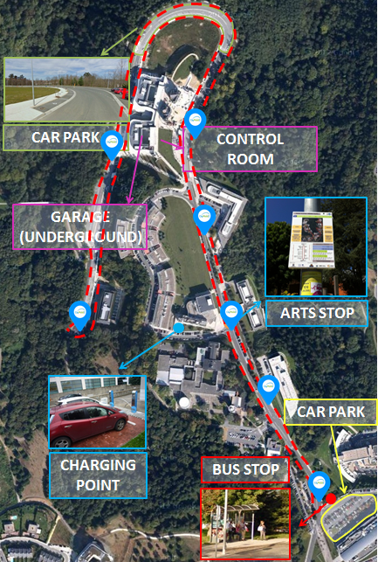
Miramon: Demo
System demonstration:
From February to June 2016
Total Distance (go & back): 3,6 km
3 vehicles
Mixed mode: On demand & frequency
Garage underground
Parking for vehicles
Control Center & Charging points
Bus stops for the ARTS
9

Slide 10
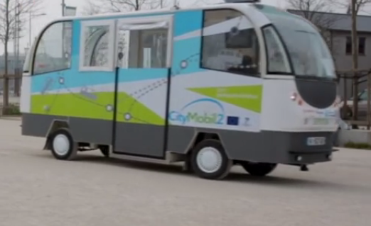
CityMobil2: Vehicle
3 vehicles
Providers: Robosoft y Easymile
Fully autonomous
Capacity of the vehicles: 10-12 p.
Maximum speed of the vehicles: 30 Km/h
Electrics
Preference to circulate against private vehicles.
10

Slide 11
CityMobil2: Next actions
Current Legislation: Permission if there is a co-pilot/vehicle.
Local Legislation: min. and simple changes, (only annex to the local rules.
Technical adaptations of the site.
Awareness campaign.
Find Co-financing
11

Slide 12
THANKS FOR YOUR ATTENTION
Jesús Murgoitio¹
María Izaguirre²
(1) Tecnalia Research & Innovation
(2) Novadays
1st MOVESMART Workshop
Renewable Mobility Services in Smart Cities:
Challenges, Approaches and Social Aspects
15th October 2015

